Slide 1


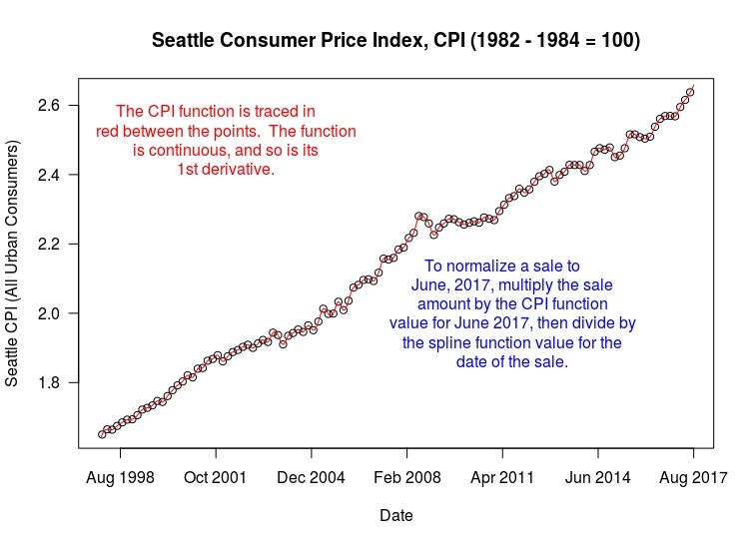
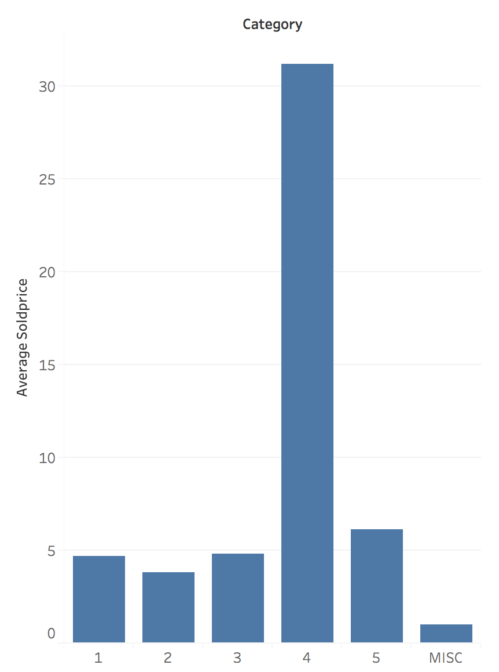
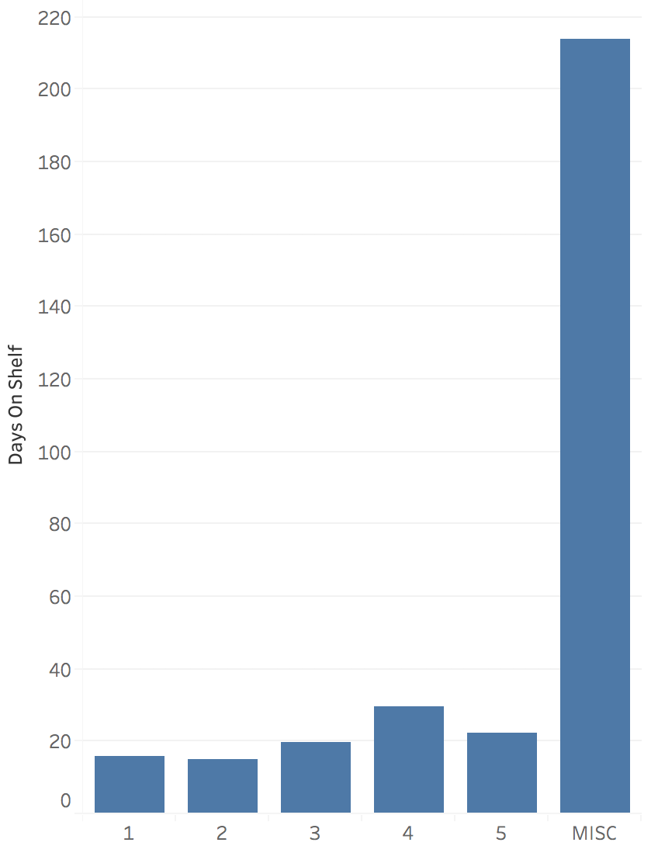
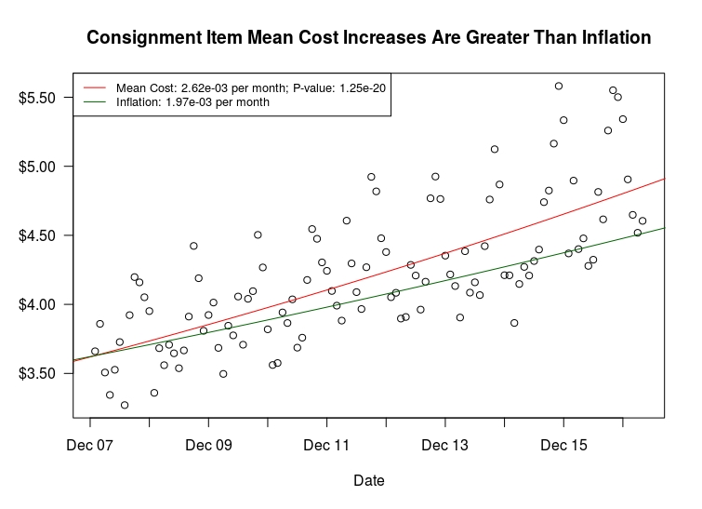
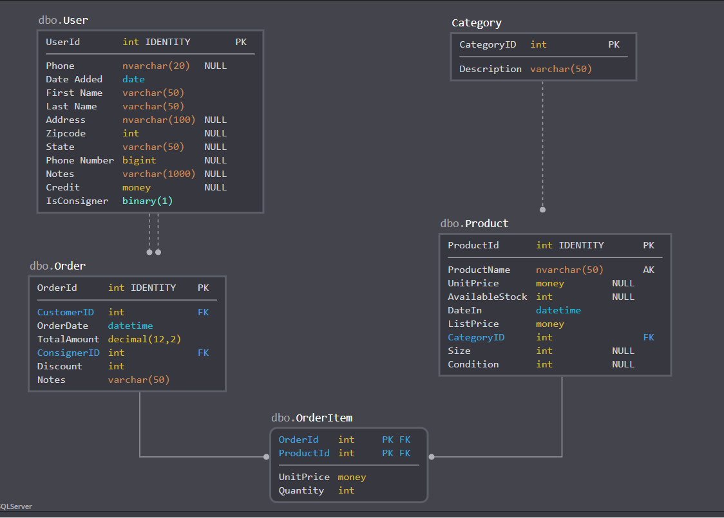
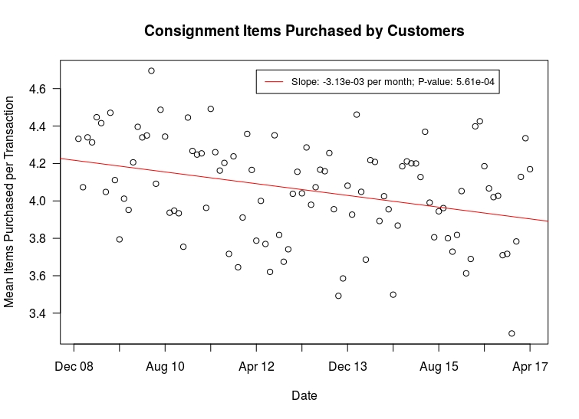
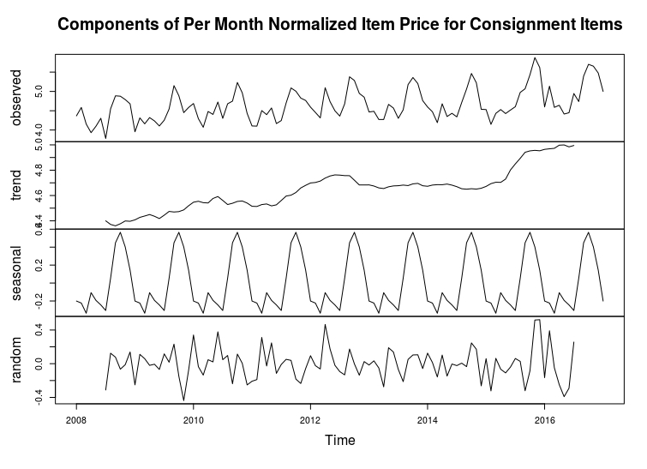
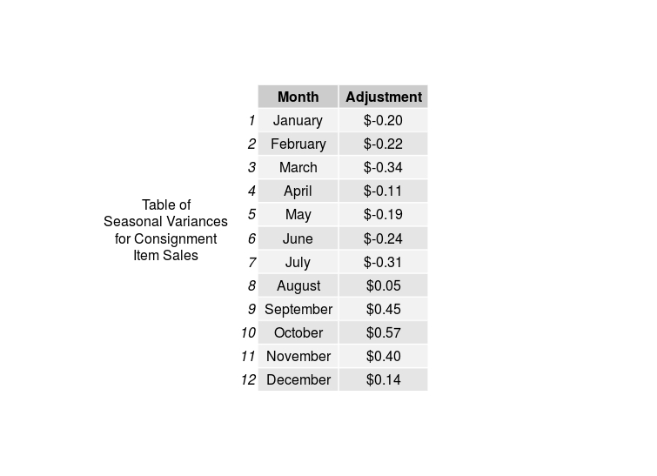
Exploratory Data Analysis of Consignment Sales
Gary Gregg, Jahnavi Jasti, Abhishek Varma
Project Proposal
Analysis Results
Kids on 45th is a mixed retail and consignment shop in the Wallingford neighborhood of Seattle, Washington. The typical Kids on 45th customer has growing children, and children outgrow clothing. As their children grow, parents will attempt to sell clothing items by consignment.
Kids on 45th says this about their customers:
We think of our consignors as friends and partners, working together to sell items quickly and for the best price.
In order to maximize revenue and keep the business as healthy as possible, it is important for Kids on 45th to price incoming consignment items correctly. Factors affected by pricing include total revenue for the store, customer satisfaction, and consignor partner satisfaction. These three factors together ultimately affect the success of the enterprise.
In June 2017, Elise and Bookis Worthy acquired Kids on 45th, and inherited several databases of data detailing ten years worth store sales and customer information. In order to better understand whether they are pricing items correctly, Kids on 45th required an analysis of the sales data that was left by the previous owners. Elise and Bookis Worthy are most interested in the question: What Sells Things? To this end, their first interest is a report with detailed analysis of the legacy sales data.
The greatest need of Kids on 45th is a detailed report of our research findings. The most important questions for the enterprise to have answered were: 1) What is the average, or mean price of consignment items per item category, and; 2) What is the average, or mean time-on-shelf of consignment items per category.
In order to conduct price analysis, we normalized all historical sales figures with the CPI. This allowed two benefits: 1) measure price trends against inflation to determine if they were less than, or greater than the trend, and; 2) normalize sale prices to a common date in time. In this case, we used the latest date available to us, which is June 2017. We used a normalizing spline function to interpolate between CPI datapoints.
The average price of an item per category is about the same, except for category 4, that includes the large items such as car seats, strollers, etc.
Most of the items are being sold in less than a month’s time. All the items that don’t get sold in a certain time go to the Dollar rack that comes under the MISC category.
We discovered that per-month mean item prices for consignment items exceeded inflation in a statistically significant way. This was in contrast to new item sales, which showed no such overall trend. In this graph, the variance in data points is high in part due to seasonal variations (back to school and holidays).
Proposed New Database Design
Meanwhile, we discovered that the number of consignment items purchased per transaction, per month declined. Was more aggressive pricing the cause? This remains an open question (see the recommendations section). However, the change may be explained two other ways: 1) economic factors over time that favor preference of consumers for new items, and; 2) Demographic changes in the Wallingford neighborhood over the time the data was collected.
Data Sources
The legacy sales data–encompassing data from the late 1980s through 2017–is contained in Microsoft Access tables. It is currently not in a form convenient for easy analysis by the enterprise. The legacy database schema is detailed below.
Custdata
Users
Sales
Customers_Finance
Customers
Cnwa
Using time series analysis, the team discovered noteworthy seasonality in prices for consignment items. The time series components included seasonality and randomness, in addition to the upward trend not explained by either. With seasonality and randomness removed, the consignment item pricing trends revealed a mutli-year cyclicity that is not yet explained
Product
ProductsBu04Older
Presets
Active_Products
Active Back-Up 3600
Recommendation
Sales
In order for usable data modelling in the future, the needs to be an overhaul in how sales, customer and inventory data is recorded. The client is now employing Square to record transactions, and we recommend using the database design shown above to store the data moving forward. We also recommend that a higher percentage of consignment goods accepted be seasonal as they seem to have the largest margins. The client should encourage customers to buy more items per transaction by giving incentives. This also captures more customer data allowing for retargeting.
Sales
Soldprod2008
Sold_Products
Drawbacks and Challenges
The seasonality of consignment item prices show the ability of the store to more aggressively price items at back-to-school time, and the holidays. Weak pricing ability occurs in the winter and spring.
The legacy databases were poorly planned and maintained, making data analysis difficult. It was impossible to join Product and Sales tables which made measuring Price Elasticity of Demand difficult. We were unable to speak with the original database designers and therefore could not clarify certain idiosyncrasies in the data. We also could not utilize the Size and Condition fields due to them not being recorded accurately for most products.
Research Tools
R, RStudio
Python, Jupyter Notebook
Tableau
SQL DBM
MS Access
MS Office
Open Office

